Slide 1
SILAC

Slide 2
INTRODUCTION
Stable Isotope Labeling by/with Amino acids in Cell culture (SILAC) is a technique based on mass spectrometry that detects differences in protein abundance among samples using non-radioactive isotopic labeling and method to study the relative proteomic change under differential treatments.
It is a popular method for quantitative proteomics that has been applied to characterize the proteomic changes between different biological samples.

Slide 3
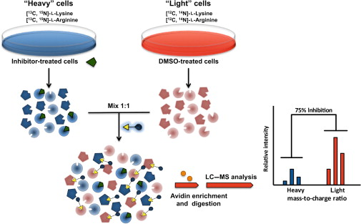
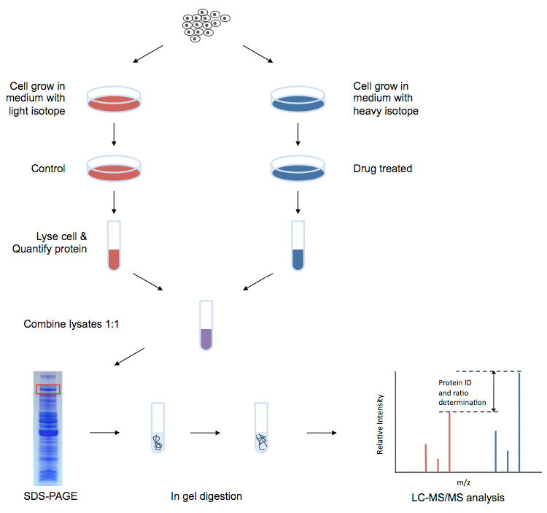
SILAC-based Proteomics Analysis Service

Slide 4
The principle of SILAC
THE BASICS SILAC was developed as a simple and accurate approach for mass spectrometric (MS)-based quantitative proteomics in CEBI (Ong et. al. MCP 2002) .
The method relies on the incorporation of amino acids with substituted stable isotopic nuclei (in this case deuterium 2H, 13C, 15N).
In SILAC, two groups of cells are grown in culture media that are identical except in one respect: the first media contains the ‘light’ ” medium that contains amino acids with the natural isotope and the other a ‘heavy’ medium that contains stable isotope labeled amino acids. After a sufficient number of cell divisions, all the proteins from the cells cultured in "heavy" medium contain amino acids in the heavy state. form of a particular amino acid (for e.g. L-leucine or deuterated L-leucine) , the cells are forced to use the particular labeled or unlabeled form. Thus, with each cell doubling the cell population replaces at least half of the original form of the amino acid, eventually incorporating 100% of a given ‘light’ or ‘heavy’ form of the amino acid.
SILAC relies on metabolic incorporation of the quantitative label and) SILAC–based quantitative MS approach for real-time recording protein-mediated cell-cell interactions we developed two stable isotope labeling of amino acids in cell culture (SILAC)-based mass spectrometry (MS)/MS ) to quantify changes of protein secretion level in a cell co-cultured system.

Slide 5
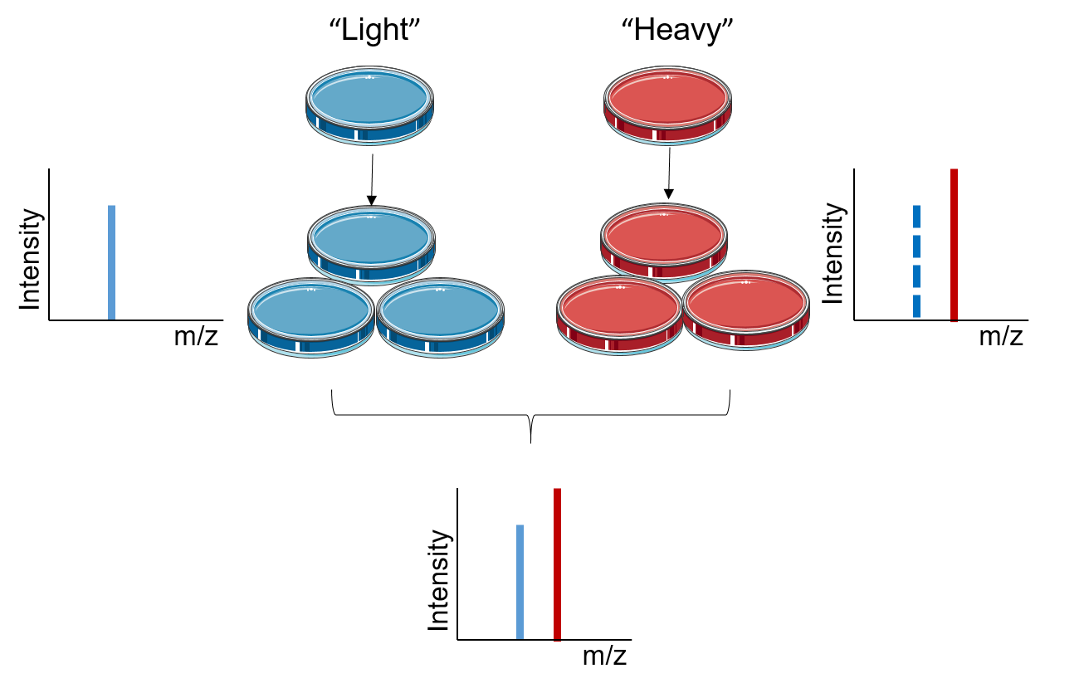
The Principle of SILAC

Slide 6
The advantages of SILAC The advantage of chemical labeling over SILAC is that it can be used to analyze a wide range of samples, including cells, tissues, and body fluids. SILAC is accepted as the best method available for quantitative proteomics in terms of easy implementation, quantitative reliability, and robustness. The disadvantages of SILAC One of the few disadvantages of SILAC is the limited number of cellular states that can be compared, because of the limited labeling combinations available when using heavy labeled amino acids.

Slide 7
Applications OF SILAC
molecular mechanisms of these complex interplays, the secreted protein analysis between malignant cancer cells and the surrounding nonmalignant stroma is a good viewpoint to investigate cell-cell interactions.
A SILAC approach involving incorporation of tyrosine labeled with nine carbon-13 atoms (13C) instead of the normal carbon-12 (12C) has been utilized to study tyrosine kinase substrates in signaling pathways.
SILAC has emerged as a very powerful method to study cell signaling, post translation modifications such as phosphorylation, protein–protein interaction and regulation of gene expression.
In addition, SILAC has become an important method in secretomics, the global study of secreted proteins and secretory pathways.
It can be used to distinguish between proteins secreted by cells in culture and serum contaminants.
Standardized protocols of SILAC for various applications have also been published.
While SILAC had been mostly used in studying eukaryotic cells and cell cultures, it had been recently employed in bacteria and its multicellular biofilm in antibiotic tolerance, to differentiate tolerance and sensitive subpopulations.

Slide 8
Pulsed SILAC Pulsed SILAC (pSILAC)
is a variation of the SILAC method where the labelled amino acids are added to the growth medium for only a short period of time.
This allows monitoring differences in de novo protein production rather than raw concentration. It had also been used to study biofilm tolerance to antibiotics to differentiate tolerant and sensitive subpopulations
NeuCode SILAC
Traditionally the level of multiplexing in SILAC was limited due to the number of SILAC isotopes available. Recently, a new technique called NeuCode (neutron encoding) SILAC.
has augmented the level of multiplexing achievable with metabolic labeling (up to 4).
The NeuCode amino acid method is similar to SILAC but differs in that the labeling only utilizes heavy amino acids.
The use of only heavy amino acids eliminates the need for 100% incorporation of amino acids needed for SILAC.
The increased multiplexing capability of NeuCode amino acids is from the use of mass defects from extra neutrons in the stable isotopes.
These small mass differences however need to be resolved on high resolution mass spectrometers.

